Slide 1
ABC Call Volume Trend Analysis

Slide 2
Project description
In the given project we have to calculate the average call duration and total number of call per hour
We had to propose a manpower plan required during each time bucket and reduce the abandon rate to 10%
We also have to propose a manpower plan when calls are received across the 24 hours

Slide 3
Approach
Data cleaning* and understanding the data set
Understanding the required insight
Making pivot tables and/or using formulas and functions to find the required insight
Making Charts for better Visualisation
* All null values are replaced by #N/A, because categorical values are missing

Slide 4
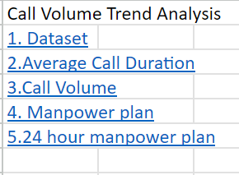
Tech stack used
I used Excel for the given project
It is a fairly powerful tool and can analyse the dataset of this size and pivot table and its formulas & functions assist in deep analysis
The charts provided excel helps in efficient data visualisation
This is the link to the Excel File https://docs.google.com/spreadsheets/d/1FCxP0qTU-_nbauSYWMBtq2A9n7CVel7h/edit?usp=sharing&ouid=111775799564275591184&rtpof=true&sd=true
Many Tables and Visualisation can be seen in the excel sheets , this is the table of contents of the excel sheet
Here is the link to loom video Explanation https://www.loom.com/share/7c98f501d21148039ef094c24f0ccad3?sid=d5c955d4-e750-49be-8418-610228c51702

Slide 5
insights

Slide 6
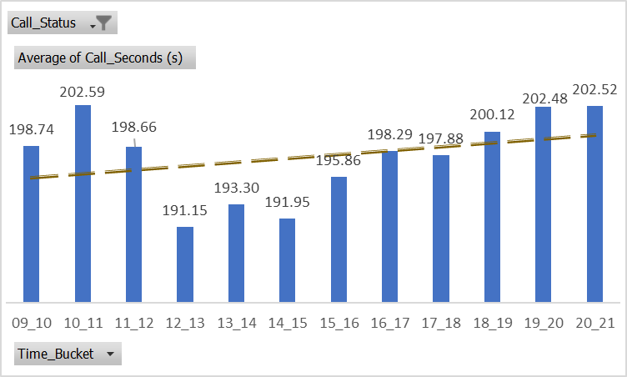
Average call time in each time bucket
An Overall Increasing Trend from 9am to 9pm with average duration of 196.96 seconds
lowest during 12pm to 1pm slot followed by 2pm to 3pm then 1pm to 2pm
Longest duration during 10am to 11am followed by 8pm to 9pm then 7pm to 8pm
In morning hours from 9 am to 12 pm and from 6pm to 9pm the call duration is highest

Slide 7
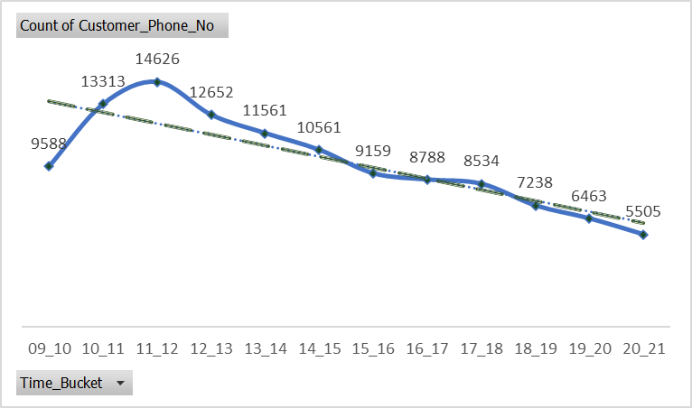
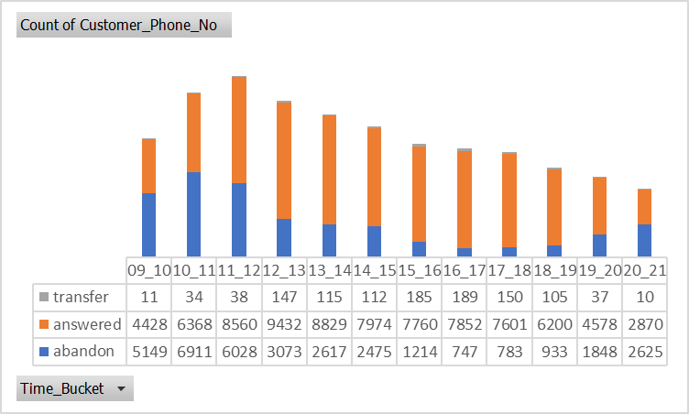
Call volume
The Call volume follows a left skewed bell curve, with the 9588 at 9am to 10am peaking at 11 to 12 with 14626 then continuously declining to 5505 in 8pm to 9pm slot
Overall decreasing trend is followed
During the initial number of hours large number of calls are abandoned, and during the last hour large number of calls are abandoned in comparison to the call answered
During the day more than 11 lakhs calls are received

Slide 8
MANPOWER PLAN
Given Assumption: An agent work for 6 days a week; On an average total unplanned leaves per agent is 4 days a month; An agent total working hrs is 9 Hrs out of which 1.5 Hrs goes into lunch and snacks in the office. On average an agent occupied for 60% of his total actual working Hrs (i.e 60% of 7.5 Hrs) on call with customers/ users. Total days in a month is 30 days.
As we can see that abandon rate is around 30% we need to propose a manpower plan which can help reduce this to 10%
Formulae Source
Hence for each bucket we need 132 agents, as call handling capacity is 99 therefore if we multiply them, we get 13068 implying that 132 agents can handle 13068 call per hour. According to previous slide only 2 slots i.e. 10am-11am which receive 13133 calls and 11am to 12pm slot which receive 14626 calls receive more calls than call handling capacity of 132 agents, but the number is not big enough so as to exceed abandon rate by 10%.

Slide 9
24 hour MANPOWER PLAN
Given Assumption: An agent work for 6 days a week; On an average total unplanned leaves per agent is 4 days a month; An agent total working hrs is 9 Hrs out of which 1.5 Hrs goes into lunch and snacks in the office. On average an agent occupied for 60% of his total actual working Hrs (i.e 60% of 7.5 Hrs) on call with customers/ users. Total days in a month is 30 days.
When only 30 calls are received we would need just 1 agent
But according to the given question we receive 30 calls at night for every 100 calls received in day

Slide 10
24 hour MANPOWER PLAN
Keeping in Mind the previous logic we require 40 agents in each time bucket based on the given data. Call Handling Capacity of 40 agents is 3967, this number is lower to only calls received at 6am-7am , 7am-8am and 8am to 9am but the difference is not much and calls abandon rate would not exceed 10%

Slide 11
Result
The project helped in understanding how to analyse call centre data and make effective insights
Further strengthening of understanding of Charts and Pivot tables in excel.
The project helped in giving a glimpse of a high stake problem where customer satisfaction and profitability needs to be kept in mind along with how the jobs of people are in balance. The Project helps in understanding how to handle this

